Slide 1
Literature Survey

Slide 2
Just a joke? A Social impact of Internet memes
Source: https://www.researchgate.net/publication/341738736_Just_a_Joke_The_Social_Impact_of_Internet_Memes
Date of publish: April,2020
Highlights:
The term 'meme' was coined by Richard Dawkins in 1976 to describe small units of culture that spread from person to person by copying or imitation”.
Whitney Phillips's This Is Why We Can't Have Nice Things is a book about the complexities of online communities, hate, and freedom of speech. Phillips discusses the act of Internet “trolling” – pranking, unsuspecting targets for personal entertainment.
The Internet allows people to become both authors and consumers with extreme ease.
The ability to publish anything, unfiltered, has generated an interesting tapestry of content. Any person with Internet access can post their thoughts online.
“[Digital media] make it possible for the first time in history to produce, edit, process, store, copy, distribute, and retrieve knowledge [using a single] technical medium.”9 With these new advantages, the meme found a space to thrive: the Internet.
Phillips notes, “trolls are widely regarded as the primary obstacle to a kinder, gentler, and more equitable Internet”. As increasing numbers of people share content every day, the amount of imagery online is expanding. Users can customize memes to suit their own interests. This means that the same meme, once altered, can be shared across a range of web communities. With the Internet so socially divided ,thus quality is extremely important.
Memes to Process Trauma.

Slide 3
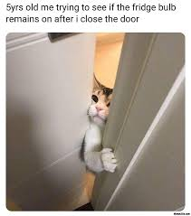
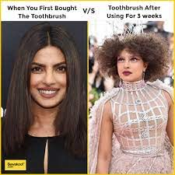
Hateful Memes:
Our goal is to predict whether a meme is hateful or non-hateful. This is a binary classification problem with multimodal input data consisting of the meme image itself (the image mode) and a string representing the text in the meme image (the text mode).Given a meme image file, and a string representing the text in the meme image, our trained model should output the probability that the meme is hateful, where a meme would be classified as hateful if this probability is larger than 0.5.
Non Hateful Memes
Hateful Memes
vs

Slide 4
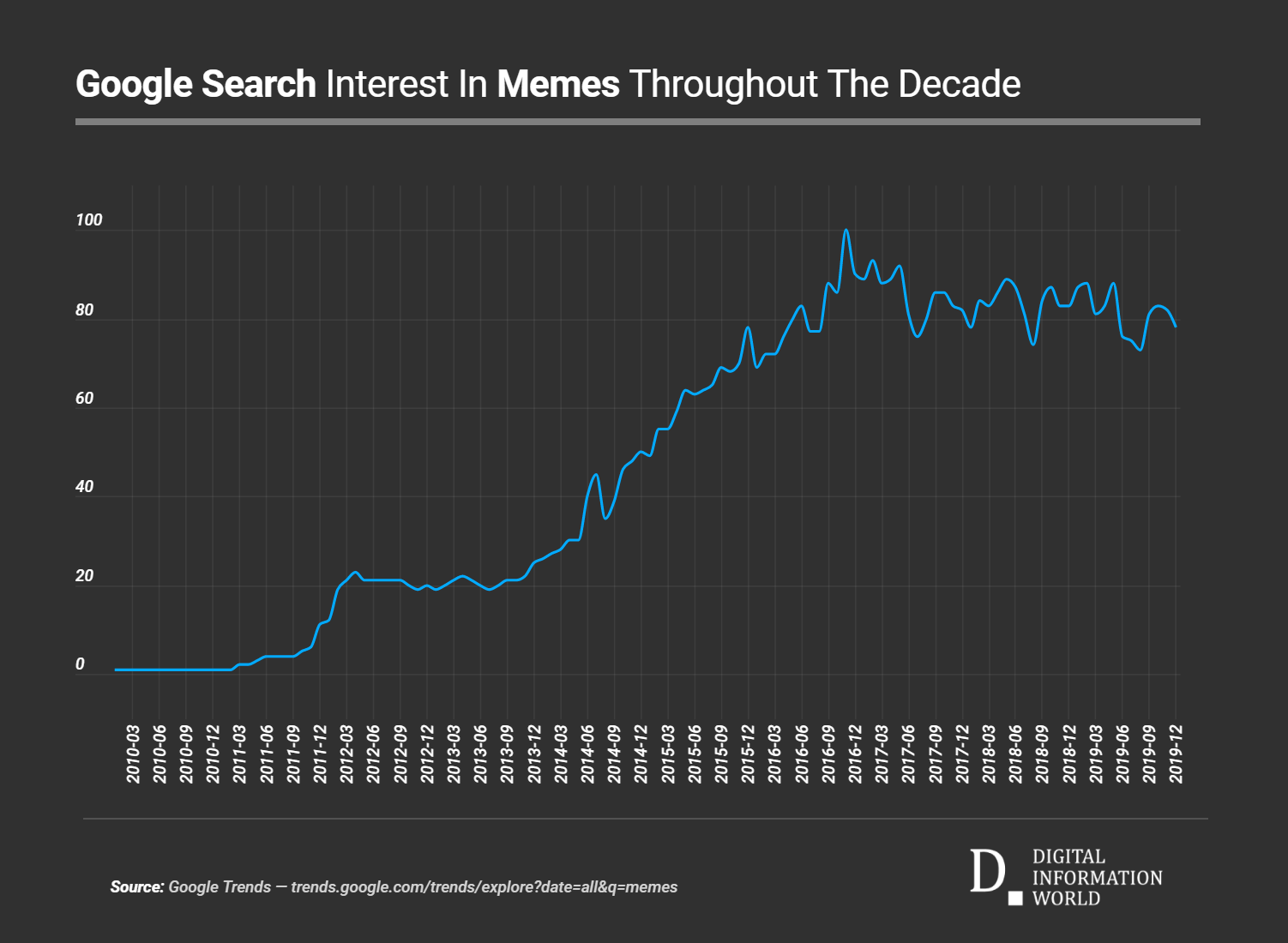
Rise of memes

Slide 5

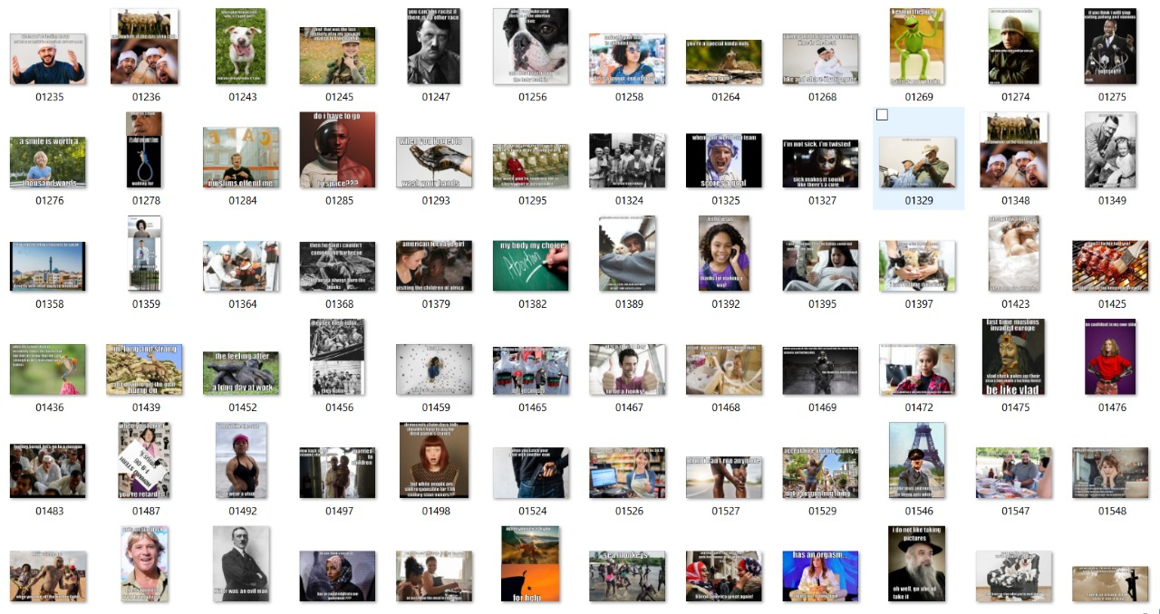
Data sets
1.Meme generator
2. Flickr images: http://graphics.cs.cmu.edu/projects/im2gps/flickr_code.html
3. Drivendata
4. Reference: Gomez, R., Gibert, J., Gomez, L. and Karatzas, D., 2019. Exploring Hate Speech Detection in Multimodal Publications. ArXiv,.
https://drive.google.com/file/d/1S9mMhZFkntNnYdO-1dZXwF_8XIiFcmlF/view
Dataset containsLabels(0-NotHate,1 -Racist, 2- Sexist,3 - Homophobe,4 - Religion, 5 –Other Hate), Text extracted from the images using OCR, Contain the tweets IDs used in the 3 splits

Slide 6
Works done :
Reference Paper 1 : “Multimodal Hate Speech Detection in Memes.”
Author: Benet Oriol Sabat.
Work Summary : This thesis explores a multimodal approach to Hate Speech detection, involving vision and language (text). More specifically, we deal with the context of memes, a form of internet humour which will present additional challenges. Also study different ways to fine-tune pretrained descriptors for their specific task.
Introduction :
Memes are a form of humourist content which is normally based on an image, and most of the time some sort of text such as a caption.
This format has also been used to produce hate speech in the form of dark humour.
The multimodal (combined) analysis of image and text for hate speech has been a limitedly explored task, and can be used to tackle the hate memes problem.
Purpose :
To create a tool to automatically predict hate speech on memes, using both image and text modalities.
Specifications :
Pytorch API as the basic deep learning framework for development
Python language.

Slide 7
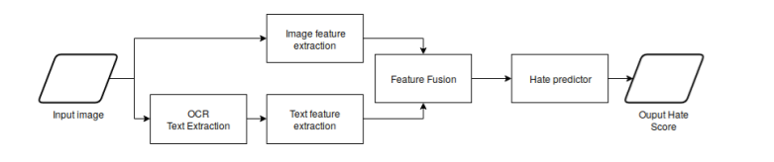
Methods :
Pretrained embedding for text and images and train a classifier with these embeddings
Implementations of BERT and VGG-16 features.
Hate speech detection :
Dataset :
Memes from Google images.(Hate memes.)
racist meme, jew meme, muslim meme.
2. Memes from Reddit Memes dataset(Non-Hateful Memes)
Architecture :
Using OCR – Extract the text of the image(pytesseract)
Text Embeddings – BERT (bert-base-multilingual-cased.)
Image Embeddings – VGG-16 (Pre-trained on ImageNet)
Fusion and the classifier -

Slide 8
Experiments :
Text descriptors : VGG-16 and BERT
Classifier : A Multi-Layer Perceptron (MLP) with two Hidden Layers, Hidden size = 100
Optimizer: SGD with momentum, learning rate = 0.01, momentum = 0.9, Batch size = 30.
Result : Large loss functions.
Optimizer : Adam with β1 = 0.9 and β2 = 0.999.
Improved accuracy (84%)
Possible Other Descriptor : XLNET model which has been proved to outperform BERT.
Conclusion : The quality of the annotations was very bad, and this has probably been one of the main limitation of the project and reasons to get much worse training and evaluation of the model.

Slide 9
Reference Paper 2 : “VISUALBERT: A SIMPLE AND PERFORMANT BASELINE FOR VISION AND LANGUAGE”
Authors: Liunian Harold Li, Mark Yatskar, Da Yin , Cho-Jui Hsieh & Kai-Wei Chang
Work Summary : They propose VisualBERT, a simple and flexible framework for modeling a broad range of vision-and-language tasks.
Further they propose two visually-grounded language model objectives for pre-training VisualBERT on image caption data.
Introduction :
VisualBERT - Integration of “BERT” a recent Transformer-based model for natural language processing, and pretrained object proposals systems such as “Faster-RCNN”.
The text and image inputs are “jointly processed” by multiple Transformer layers in VisualBERT.
Pre-training VisualBERT on image caption data(COCO)- Part of the text is masked and the model learns to predict the masked words based on the remaining text and visual context;
The model is trained to determine whether the provided text matches the image.

Slide 10
Procedure :
1. Task-Agnostic Pre-Training :
Train VisualBERT: Using COCO image caption dataset using two visually-grounded language model objectives.
Masked language modeling with the image. Some elements of text input are masked and must be predicted but vectors corresponding to image regions are not masked.
Sentence-image prediction: For COCO, where there are multiple captions corresponding to one image, we provide a text segment consisting of two captions. One of the caption is describing the image, while the other has a 50% chance to be another corresponding caption and a 50% chance to be a randomly drawn caption. The model is trained to distinguish these two situations.
2. Task-Specific Pre-Training : Before fine-tuning VisualBERT to a downstream task, they find it beneficial to train the model using the data of the task with the masked language modeling with the image objective. This step allows the model to adapt to the new target domain.
3. Fine-Tuning : This step mirrors BERT fine-tuning, where a task-specific input, output, and objective are introduced, and the Transformer is trained to maximize performance on the task.

Slide 11
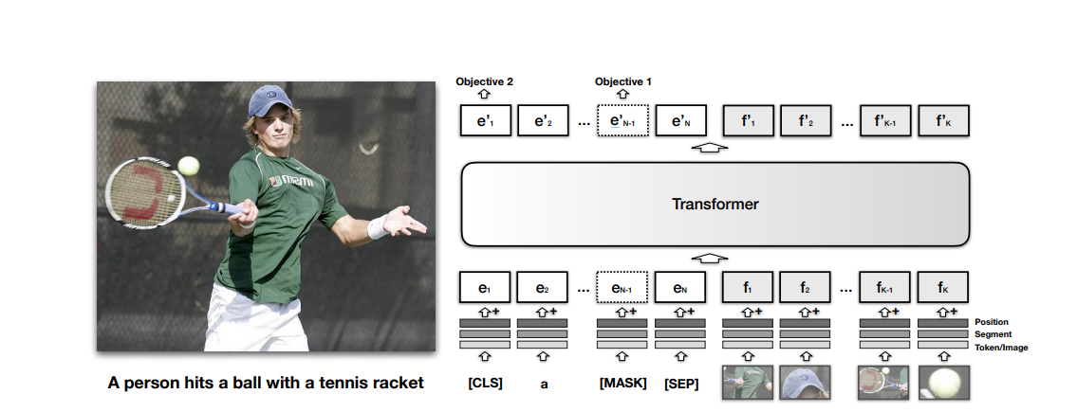
Experiment :
Visual Question Answering (VQA 2.0)
Visual Commonsense Reasoning (VCR)
Models :
VisualBERT: The full model with parameter initialization from BERT that undergoes pre-training on COCO, pre-training on the task data, and fine-tuning for the task.
VisualBERT w/o Early Fusion: VisualBERT but where image representations are not combined with the text in the initial Transformer layer but instead at the very end with a new Transformer layer. This allows us to test whether interaction between language and vision throughout the whole Transformer stack is important to performance.
VisualBERT w/o COCO Pre-training: VisualBERT but where they skip task-agnostic pre-training on COCO captions. This allows to validate the importance of this step.
Optimizer for all Models : SGD with Adam.

Slide 12
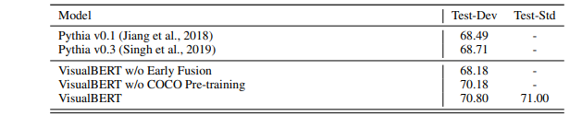
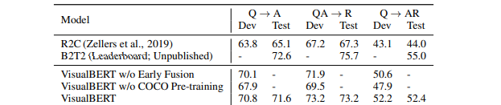
1. VQA :
Dataset : VQA (2.0) :
COCO images (all of current train/val/test), Questions ,ground truth answers
Training : Faster RCNN for image features.
2. VCR :
Dataset : VCR
objects: a list of objects detected
img_fn: the filename of the image
question: Tokenized version of the question.
answer_choices: A list of four answer choices, with the same format as question.
answer_label: Which answer (0 to 3) is right in answer_choices.
Conclusion : Despite VisualBERT is simple, it achieves strong performance on these above evaluation tasks.

Slide 13
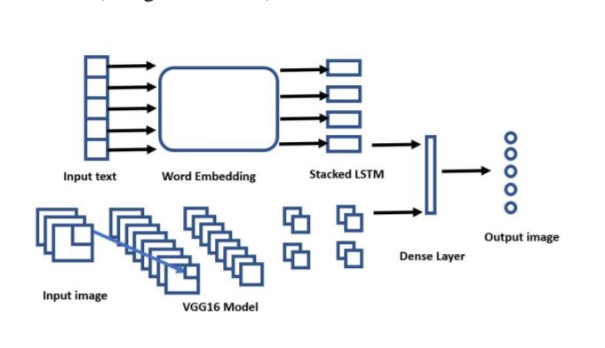
Reference paper 3: Multimodal Meme Dataset (MultiOFF) for Identifying Offensive Content in Image and Text https://www.aclweb.org/anthology/2020.trac-1.6.pdf
Text Transformation:
The text has been transformed into vector sequence using word embidding.
Baseline Model for Images:
A CNN architecture developed by the Visual Geometry has been used to classify the targeted image data.
Images were loaded into an array and changed into a fixed shape as per VGG16 specifications

Slide 14
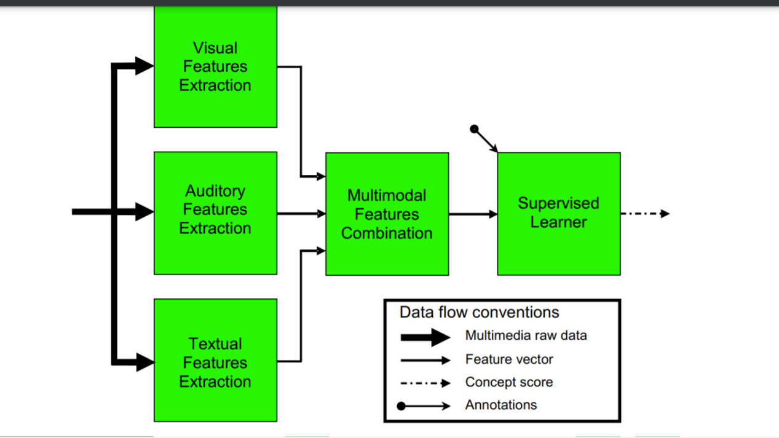
Multimodal Approach:
”Early Fusion Approach”is used.
In an embedding, words are represented by dense vectors where a vector represents the projection of the word into a continuous vector space.
A new vector has been formed by the concatenation of both modalities which represents a meme as a whole and hence can be used for classification.
.

Slide 15
continueed..
On the one hand, pre-trained VGG16 on the ImageNet dataset has been used for images, while GloVe has been used to represent word embeddings.
The inclusion of more training data will help us to understand it. For automatic evaluation of a meme, we need text as the different modality. This text is often embedded on the meme.
Hence to capture the embedded text, we can use OCR techniques instead of word embedding to improve the performance.
Data set : Meme generator dataset
.

Slide 16
Hateful Memes Challenge 2020, SEP 22 Yuval Nirkin Assaf Rabinowitz Yoni Solel
Data Processing
Text embedding :SBERT A modification of the pretrained BERT network that uses siamese and triplet network structures to derive semantically meaningful sentence embeddings.
Image Embedding: MobileNetV3
Hypernetworks
Inital approach
Extracting text and image features like Mean Value for each RGB coordinates, Image caption,Caption profanity probabliy. Subparts of text , text profanity etc.
Two separate classifiers using the extracted features:
Linear Regression SVM classifier
Varun Bohara

Slide 17
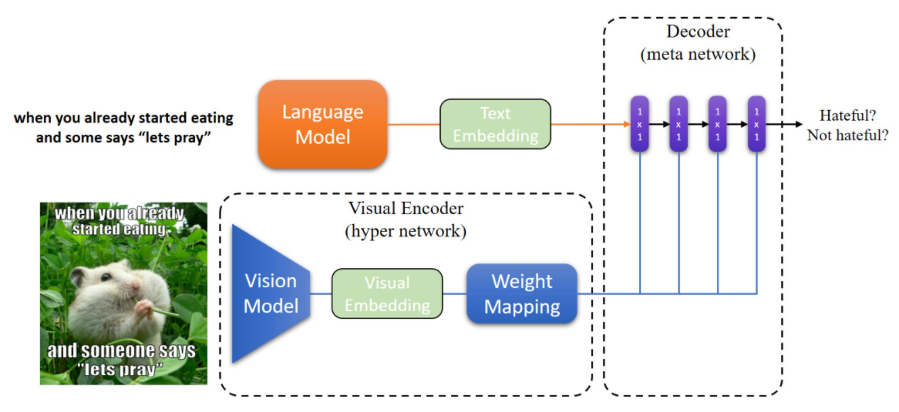
Model Description
The model based onto the hypernetwork.
The hypernetwork is a network that predicts the weights of another larger network.
The language model is based on SBert, it accepts the image's text and produces the text embedding Et.
The vision model accepts the image as input and produces the visual embedding Ev(768)
Ev is then fed to the weight mapping module, producing a set of weights θ.
The decoder is defined as a function f(Et,θ),that outputs the final binary prediction, is the image hateful or not hateful?
Varun Bohara

Slide 18
Training
The model is trained end-to-end with the vision model pretrained on ImageNet [11], and the weight mapping module .
The language model is pretrained on Wikipedia [12] and its weights remain frozen for the entire training process.
Adam optimizer (β1=0.5,β2=0.999) with learning rate 0.0001, which we decrease by half every five epochs, and a batch size of 4.
All images are resized and padded to a resolution of 800x800, and randomly horizontally flipped with probability 0.5.
Results and future work
Using the complete model as described in the previous section the AUC score acheived is 0.6707.
Attention mechanism can be utilized to allow the network to only focus on the important parts of the image .
Avoiding the processing of the text regions can help focus the network on the important parts of the images and increase the efficiency of the network
https://arxiv.org/pdf/1609.09106.pdf
https://medium.com/pytorch/bootstrapping-a-multimodal-project-using-mmf-a-pytorch-powered-multimodal-framework-464f75164af7
https://www.linkedin.com/pulse/training-better-text-classifiers-less-data-transfer-pikusa-ph-d-/
Varun Bohara

